Slide 1
HYDROCEPHELUS ASSOCIATION WORKSHOP
The Drug Discovery Process And the Role of the Academic Researcher
      April 12th - 13th , 2024 Cincinnati Childrens Hospital
            Bruce F. Mackler, Ph.D., J.D.
          bruce@brucefmackler.com
          tel: 301-529-6984
  Goal: to increase your understanding of some potential research issues and how they may impact on FDA issues

Slide 2
THE DRUG DISCOVERY PROCESS AND THE ROLE
OF THE ACADEMIC RESEARCHER
Workshop Focus:
  1. Design and quality control manufacturing of the drug candidate for clinical studies in terms of production, contaminants, and provide information for them to design quality control assays.
  2. Provide basic understanding of how a candidate drug interacts with biological systems associated with a disease to understand its mechanism of action of the drug,
  3. Enables the development and design of FDA mandated preclinical studies to assess the safety of a drug candidate in appropriate animal models, choice of dosing and dosing regimen,
  4. Enables the development and design of FDA regulated human clinical studies to assess safety and efficacy of a drug candidate (choice of clinical endpoints) and provide clinical data for market approval.

Slide 3
Bruce F Mackler, Ph.D., J.D. Biosketch
Dr. Mackler has 30 years of FDA legal/regulatory experience in biomedical products – drugs, biologics, medical devices and in vitro diagnostic, and nutraceuticals – development. He has advised both early stage and multinational biopharmaceutical companies in product development, organized successful preclinical/clinical meetings with FDA, Health Canada, European Medicines Agency (EMA), Japan Pharmaceuticals and Medical Devices Agency, Australia TGA, Israeli Ministry of Health, etc.
Dr. Mackler has help develop successful Investigational New Drug (INDs) for companies and clinicians (sponsor INDs), and held an IND for a Phase III Multiple Sclerosis drug clinical efficacy and safety trial used for subsequent market approval (NDA); as well as participated in the NDA submissions and approval for several other drugs.
He has also audited and monitor human clinical trial to assess their compliance with FDA Good Clinical Practices (GCPs), performed manufacturing audits, and counsel for companies undergoing FDA inspections/audits.
Dr. Mackler has a MS/Ph.D. in Immunology/microbiology, has authored over 100 papers and abstracts, as well as briefing papers and FDA related legal and regulatory issues. Dr. Mackler in the 1980’s served on a NIH, NIDR study section, retiring when he became a lawyer. In the early 2000’s, he was invited again to serve on an extramural SBIR Study Section, NIHLB, reviewing the FDA strategies commitments in SBIR submissions.
Dr. Mackler as a researcher received several NIH grants to support his research. A complete biosketch can be found in the appendices.

Slide 4
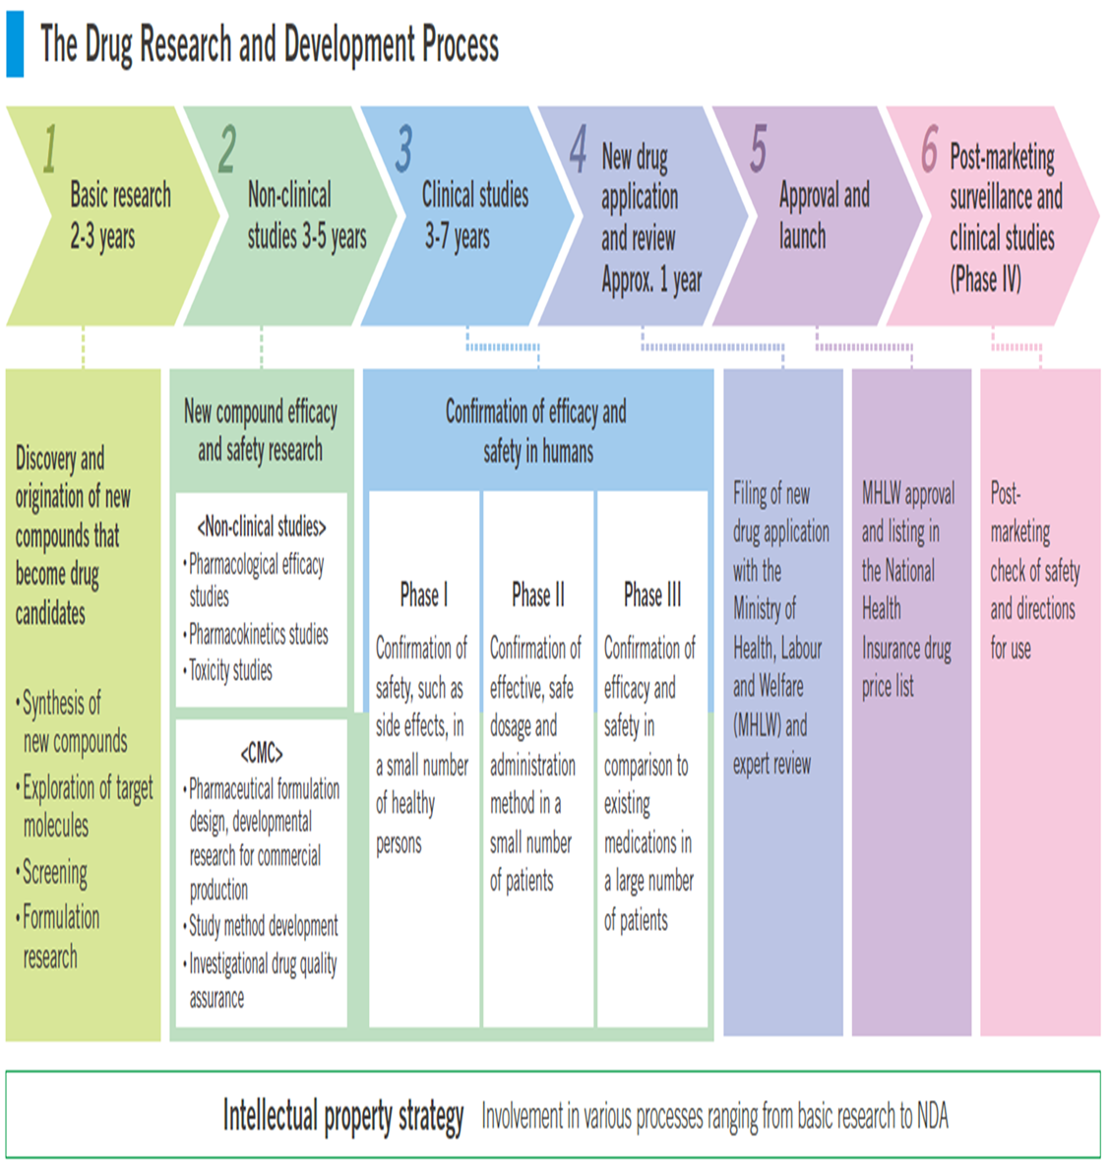

New Drug R & D Process 9-15 years

Slide 5
Basic Research Focus of Academic Drug Discovery
Studies intended understand the underlying biology of a disease, identify the biological pathways through which the disease can be treated, and drugs that can modify the disease.
  Academic promising drugs frequently tested in laboratory cell lines and in animal (rabbit, dogs, pigs) in non-GLP studies [Good Laboratory Practice Regulations]
    Researchers need to manufacture/formulate drug used is such studies in a manner that mirrors the final drug, which is very difficult. Alternatively, researchers can …
      Keep sample of drug used in appropriate storage, so one can compare this early drug formulation with later drug formulations
      Researchers should develop a stability indicating assay(s) to confirm stability of early drug sample kept in storage.
  Note: early drug sample can be less pure, which could help to define negative activities of potential contaminants, at lower concentrations in purer final drug formulations
Basic Research studies are not regulated by FDA, but can be useful to FDA

Slide 6
Understanding FDA’s Concerns
FDA regulations and drug regulations operates on precedent and analogue with drugs it has previously approved. FDA experience with particular disease and drugs are discussed in FDA Guidance for Industry:
  FDA Guidance for Industry represents FDA’s current thinking on a topic – design of animal studies, drugs approved for related diseases, safety concerns, …. Examples:
    Cerebral Spinal Fluid (CSF) Shunt Systems, 7/16/2028
    Acetazotamide (Diamox) & Furosemide
    Carbonic anhydrase inhibitors
  If the drug you are studying has been previously approved look at it package insert to describe safety testing requirements, human adverse events associated with the drug, metabolic pathways (toxicity of drug’s breakdown products,…).
  Can also download the FDA review package for approved drugs: example
  ACETAZOLAMIDE A207659 CAPSULE, EXTENDED RELEASE
  ORAL 500MG AB (Therapeutic equivalnce) ACCORD HEALTHCARE INC
          SEE: Orange Book or www.accessdata.fda.gov

Slide 7
Academic Meetings With FDA (Drugs/Devices)
Strategy for FDA Meetings:
  First: Identify the questions you need to resolve with FDA impacting on your R & D research in order to better focus your research efforts
  Second: Prepare a dossier with experimental information to frame each question asked of FDA to give them background information sufficient to answer your question:
    Include any safety findings (particular effects on major organ systems)
    Give FDA supporting data, as well as data, include positive & negative data
    How will it be administered – oral, sublingual, injection?
    Usual dossier length 40-50 pages, attach only 1-2 key references or tables of raw data from critical studies
  Third: Decribe possible clinical focus of the new drug in terms of what you hope to prove, as to whether it will be:
    Equally efficacious as an existing drug
    More or less efficacious than an existing drug
      If there is no existing approved drug, then tell FDA your goal of what clinical claim you hope to make
    Safer than an existing approved drug > a drug which reduces serious adverse events is approvable

Slide 8
FDA Speak Nuances
Today many academic researchers focusing on clinical problems, find it helpful to talk with FDA, and secure their advice, so they can generate data that anticipates potential FDA issues
Remember FDA is not your consultant, do not ask them what to do!
  Tell them what you plane and ask their advice and recommendations
How to Phrase a Question to the FDA:
  Q: Based on the experimental data, we propose to follow the enclosed draft animal studies protocol. Do you agree that this draft protocol could provide data to support a Phase 1 human study? If not, could you explain what protocol modifications would be recommended?
    If you later decide to do something different, based on some scientific rationale, then merely document scientifically, why it was experimentally appropriate to do so.
FDA is inherently suspect of all published scientific articles, because they suspect that the data has been “selected” for publication.
    Show raw data from multiple experiments in table/chart

Slide 9
NIH SBIR Funding and FDA Concepts
SBIRs are evaluated both scientifically and also on their understanding and addressing the FDA process to move the research into a product.
  Need a corporate partner
  It is not sufficient to merely say that one has an FDA regulatory consultant on board, need a viable FDA strategy as to how you are going to move the R & D product through the FDA approval process
  Need to discuss specifically how the researcher intends to address the FDA requirements
  Explore NIH Commercialization Readiness grants address
    How you are going to addess specific FDA regulatory requirements
    Identify appropriate animals to evaluate safety
    Explore metabolism/catabolism – organs and pathways involved

Slide 10
PreClinical Development Phase
Academic vs. GPL Animal studies
  Academic studies (mouse, rabbit, dog, pig,…) are exploratory and do not support FDA safety evaluation, but can help define an eventual GLP animal protocol.
    Problems:
      do you use GMP compliant drug product?
      How closely related is your experimental drug product to the final drug formulation?
    Solutions:
      GMP-like (document manufacturing, use reference samples, verify processes,…)
      Retention sample – need stability indicating assay to show no loss of activity upon storage
  Good questions to ask in academic animal studies of FDA relevance:
    Maximum tolerated dose
    Target organs (safety)
    Blood levels over time (defining catabolism)
    Adverse events

Slide 11
Moving Into FDA Studies: terminology
Safety Data: 60-90 day studies in two “appropriate” animal species.
Clinical Phase:
  Pre-IND Meeting: layout your clinical development plan, can be limited to Phase1
  Investigator- (Academic) Sponsor IND
    Many institution, such as the Cincinnati Childrens Hospital have FDA regulatory groups to guide academic investigators, monitor and audit clinical studies, and assist investigators in filing FDA reports
  Investigator (Corporate sponsor) IND
  Clinical Development process:
    Phase I (1) safety……………….. (20-50 patients/volunteers)
    Phase II (2) safety & efficacy.. (100-200 patients)
    Phase III ( 3) safety & efficacy (200-1000 patients)….termed pivotal studies for approval
    Submission of New Drug Approval Application (NDA)

Slide 12
Questions: What type of Drugs Are Approvable?
More efficacious drugs:
  Never claim a drug is more efficacious eventhough you believe it to be – let the clinical data speak for itself (more efficacious is a marketing claim)
  Never claim a drug will cure a disease, because FDA will ask for a very high burden of proof, such as needing a very high number of patients in Phase III, and long-term studies for years to show no remission.
Can a drug equally or less efficacious be approved by FDA? YES
    Equally efficacious – will have to do head to head phase III clinical studies to substantiate – do not claim, but let the data speak for itself.
    Less efficacious – if the drug has a better safety profile – less serious adverse events… termed a safer drug, but will require head-to-head Phase III clinical studies
TODAYS’ FORMAL PRERSENTATION STOPS HERE - the extra materials in your workshop handout are offered as a resources

Slide 13
DRUG DISCOVERY PROCESS & ROLE OF
ACADEMIC RESEARCHER
                Bruce F. Mackler, Ph.D., J.D.
                FDA Advisor
  If you have further questions, please give them to Dr. Monica Chau, and I will try and respond by email as a courtesy

